Slide 1

Optimization Of Medical Inventory

Slide 2

Project Leadership
Sharat Manikonda
Director at Innodatatics and Sponsor
linkedin.com/in/sharat-chandra

Slide 3

Team Members
Name: Manikanta Damacharla.
LinkedIn Profile :- Manikanta Damacharla
Name: Manikanta Damacharla.
LinkedIn Profile :-
Manikanta Damacharla

Slide 4

Contents
Business objective
Business Constraints
Project Architecture
Data collection and details
Data Information
Data Dictionary
Exploratory Data Analysis
Missing values Observation
Data Preprocessing
Visualization
Screen shot of output
Challenges
Future Scopes
Notes:
Change

Slide 5
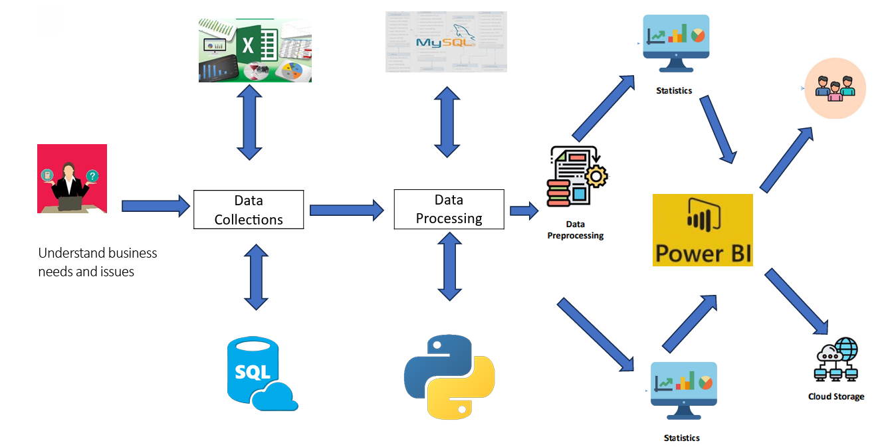
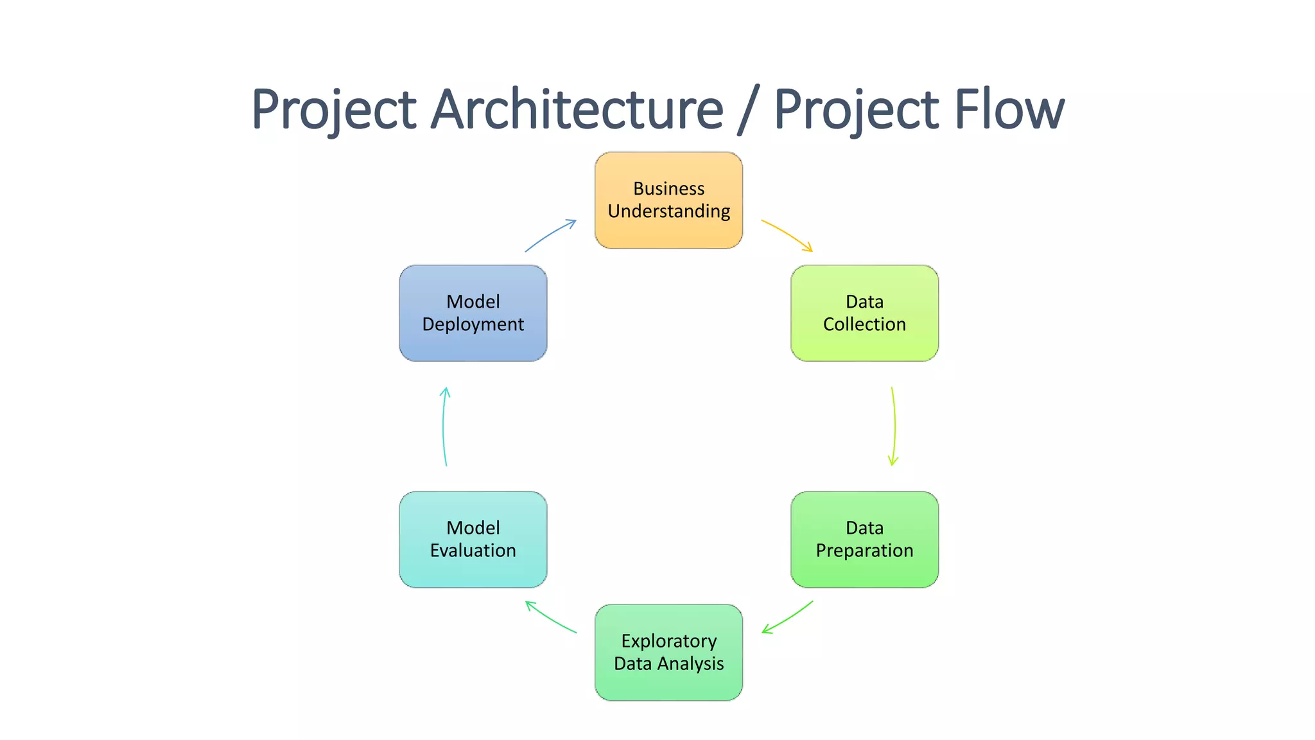
Project Overview and Scope

Slide 6
Business Problem
Bounce rate is increasing significantly leading to the patient dissatisfaction.

Slide 7
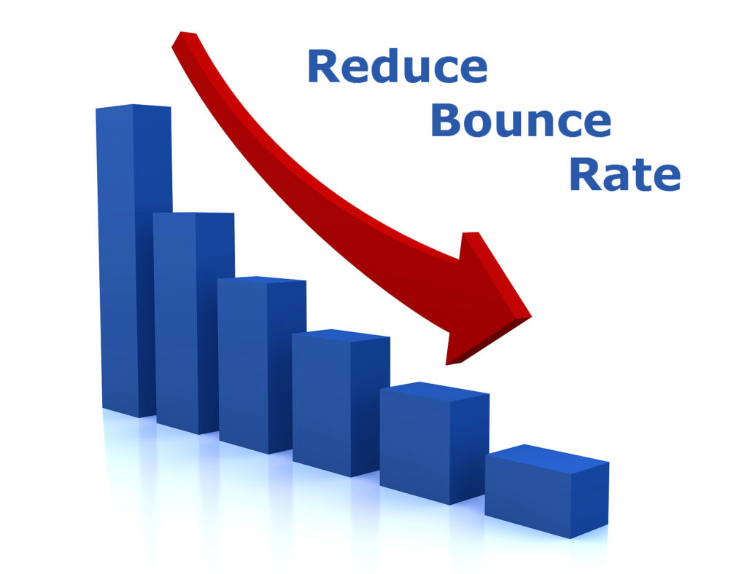

Business Objective
Objective
Minimize Bounce rate
Constraints
Minimize inventory cost

Slide 8
Methodology
1.Business and data understanding
2.Data preparation a. Exploratory Data Analysis(EDA) b. Data Preprocessing
3.Data Visualization a. Power-BI

Slide 9








Technical Stacks
Exploratory Data Analysis(EDA)
and
Data Pre- Processing
Visualization

Slide 10
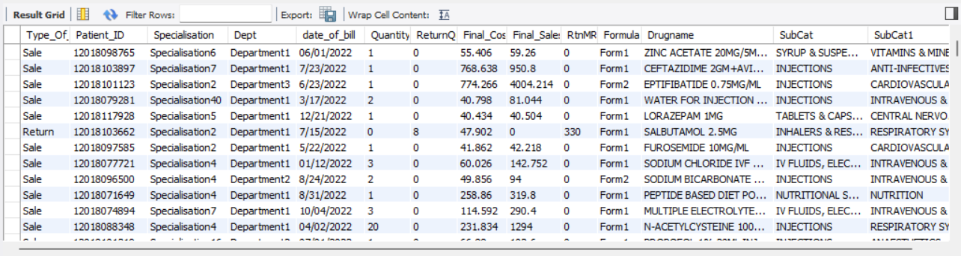
Data Collection and Understanding
Medical Inventory Optimization Dataset
Data collection for medical inventory optimization dataset.
this is a secondary data collection.
The medical inventory optimization dataset is of type (14218, 14), which indicates that it has 14218 rows and 14 columns.

Slide 11
Data Information
Our dataset contains several key fields for analyzing sales . Like Patient_ID, Specialisation, Dept, Dateofbill, Quantity, return Quantity, finalcost,fonalsales,rtnMRP,formulation,DrugName,Subcat and subcat1 provide contextual information for each transaction.
The primary focus of this analysis lies in the Quantity and Return_Quantity columns. These columns capture the volume of items sold and returned, respectively. This data is critical for calculating inventory turnover rates, which can help identify potential overstocking or understocking issues.
Additionally, the Final_Cost and Final_Sales columns offer insights into the financial performance of each transaction. Analyzing these fields allows for the assessment of profitability and revenue generation.
Finally, the DrugName and SubCat fields provide valuable product-level details. Understanding which drugs are being sold and their respective categories is crucial for gauging product popularity, market demand, and ultimately, implementing effective inventory management strategies

Slide 12
Data Dictionary
Sn. No | varialbe name | Variable Description | Data Type
1 | Typeofsales | Type of sale of the drug. Either the drug is sold or returned. | Categorical (String)
2 | Patient_ID | ID of a patient | Numeric
3 | Specialisation | Name of Specialisation (eg. Cardiology) | Categorical (String)
4 | Dept | Pharmacy, the formulation is related with. | Categorical (String)
5 | Dateofbill | Date of purchase of medicine | Date
6 | Quantity | Quantity of the drug | Numeric (Integer)
7 | ReturnQuantity | Quantity of drug returned by patient to the pharmacy | Numeric (Integer)
8 | Final_Cost | Final Cost of the drug (Quantity included) | Numeric (Float)
9 | Final_Sales | Final sales of drug | Numeric (Float)
10 | RtnMRP | MRP of returned drug (Quantity included) | Numeric (Float)
11 | Formulation | Type of formulation | Categorical (String)
12 | DrugName | Generic name of the drug | Categorical (String)
13 | SubCat | Subcategory (Type) to the category of drugs. | Categorical (String)
14 | SubCat1 | Subcategory (condition) to the category of drugs | Categorical (String)

Slide 13
System Requirements
Edition Windows 11 Home Single Language
Version 22H2
OS build 22621.3296
Experience Windows Feature Experience Pack 1000.22687.1000.0
Processor 12th Gen Intel(R) Core(TM) i5-1235U 1.30 GHz
Installed RAM 8.00 GB (7.68 GB usable)
System type 64-bit operating system, x64-based processor
Need to Install Anaconda, with Spyder, Python, and libraries like NumPy, Pandas, and Matplotlib for data analysis and visualization.
Need to Install MySQL Community Edition, which includes the MySQL database server and MySQL Workbench for database management and development.
Need to Download and install Power BI Desktop from the Microsoft website. Power BI Service can be accessed through a web browser.

Slide 14
Exploratory Data Analysis [EDA]
The medical_dataset comprises 14,218 records and includes essential columns such as Typeofsales, Patient_ID, Specialisation, Dept, Dateofbill, Quantity, ReturnQuantity, Final_Cost, Final_Sales, RtnMRP, Formulation, DrugName, SubCat, and SubCat1.
Descriptive statistics for numeric columns (Quantity, ReturnQuantity, Final_Cost, Final_Sales, RtnMRP) like mean, median, variance, standard deviation, range, skewness, and kurtosis provide insights into distribution and variability, aiding in inventory planning and risk assessment. Meanwhile, mode for categorical columns (Typeofsales, Specialisation, Dept, Formulation, DrugName, SubCat, SubCat1) offers insights into common types, specializations, formulations, and drug categories, guiding procurement and inventory categorization decisions.
Notes:
EDA is used for seeing what the data can tell us before the modeling task.
Change

Slide 15
Exploratory Data Analysis [EDA]
 | First moment Business Decision | Medical Inventory Optimization Dataset (Before cleaning) | Medical Inventory Optimization Dataset (After Cleaning)
Mean | Mean Quantity: | 2.232 | 1.870
 | MeanReturnQuantity: | 0.292 | 0.23841
 | Mean Final Cost: | 124.824 | 132.872
 | Mean Final Sales: | 234.038 | 229.888
 | Mean RtnMRP: | 29.127 | 28.496
Median | Median Quantity: | 1.000 | 1.0
 | Median Return Quantity: | 0.000 | 0.0
 | Median Final Cost: | 53.650 | 54.292
 | Median Final Sales: | 86.424 | 85.812
 | Median RtnMRP: | 0 | 0.0
Mode | Mode Type of Sales: | Sale | Sale
 | Mode Specialisation: | Specialisation4 | Specialisation4
 | Mode Department: | Department1 | Department1
 | Mode Formulation: | Form1 | Form1
 | Mode Drug Name: | SODIUM CHLORIDE IVF 100ML | SODIUM CHLORIDE IVF 100ML
 | Mode Subcategory: | INJECTIONS | INJECTIONS
 | Mode Subcategory 1: | INTRAVENOUS & OTHER STERILE SOLUTIONS | INTRAVENOUS & OTHER STERILE SOLUTIONS

Slide 16
Exploratory Data Analysis [EDA]
 | Second moment Business Decision | Medical Inventory Optimization Dataset (Before cleaning) | Medical Inventory Optimization Dataset (After Cleaning)
Variance | Variance Quantity: | 26.336 | 12.400
 | Variance Return Quantity: | 2.700 | 0.8165
 | Variance Final Cost: | 216007.852 | 243015.231
 | Variance Final Sales: | 450560.406 | 475084.668
 | Variance RtnMRP: | 33217.222 | 33075.686
Standard Deviation | Standard Deviation Quantity: | 5.132 | 3.521
 | Standard Deviation Return Quantity: | 1.643 | 0.903
 | Standard Deviation Final Cost: | 464.766 | 492.965
 | Standard Deviation Final Sales: | 671.238 | 689.263
 | Standard Deviation RtnMRP: | 182.256 | 181.867
Range | Range Quantity: | 150 | 150
 | Range Return Quantity: | 50 | 20
 | Range Final Cost: | 33138 | 33138.0
 | Range Final Sales: | 39490 | 39490.0
 | Range RtnMRP: | 8014 | 8014.0

Slide 17
Exploratory Data Analysis [EDA]
 | Third and Fourth moment Business Decision | Medical Inventory Optimization Dataset (Before cleaning) | Medical Inventory Optimization Dataset (After Cleaning)
Skewness | Skewness Quantity: | 11.34 | 17.077
 | Skewness Return Quantity: | 17.171 | 7.799
 | Skewness Final Cost: | 34.505 | 32.725
 | Skewness Final Sales: | 21.005 | 21.774
 | Skewness RtnMRP: | 15.796 | 16.826
Kurtosis | Kurtosis Quantity: | 180.09 | 463.540
 | Kurtosis Return Quantity: | 409.273 | 97.091
 | Kurtosis Final Cost: | 2025.154 | 1813.450
 | Kurtosis Final Sales: | 948.189 | 967.447
 | Kurtosis RtnMRP | 403.383 | 449.712

Slide 18
Exploratory Data Analysis [EDA]
Weekly and Monthly Insights:
Quantity:
Weekly quantity sold fluctuates, with Week 50 selling the highest at 653 units, while Week 0 had the lowest at 34. Monthly sales peak in December at 2426 units, followed closely by July and August. However, February and June saw lower sales at 1635 and 1614 units respectively, hinting at seasonal demand patterns.
Quantity return:
Week 5 had the highest returns, totaling 104 units, while Week 0 had the lowest returns, with only 2 units. In terms of months, August saw the highest returns at 329 units, whereas july had the lowest returns, with only 199 units.
Total quantity sold for each drug per week and month:
“SEVOFLURANE 99.97%” was the highest-selling drug, with 215 units sold in week 3, followed by 126 units in week 48, and 100 units in week 51. In March, the drug “SEVOFLURANE 99.97%” had the highest sales, with 258 units sold.
Total sales per week and month:
The analysis reveals that December recorded the highest total sales, amounting to approximately 373536.002. Conversely, June had the lowest total sales, approximately 189623.272. In weekly terms, Week 52 saw the highest total sales of around 96458.51, while Week 0 had the lowest sales, around 3970.95.
Total final_sales for each drug per week and month:
In month 12, 'HUMAN ALBUMIN 25% INJ' had the highest sales, approximately 42442.40. In Week 52, 'PEMBROLIZUMAB' led with approximately 39490 in sales.

Slide 19
Exploratory Data Analysis [EDA]
Weekly and Monthly Insights:
Bounce rate:
The bounce rate, calculated at 24.92%, indicates that nearly a quarter of customers who made purchases ended up returning items without any final sales. This suggests potential issues with product satisfaction, quality, or fulfillment processes that might be contributing to returns without purchases.
Drug Insights:
Drug with the highest total quantity sold:
The drug "Sodium Chloride IVF 100ML" stands out as the highest seller, totaling 1278 units sold.
Drug,subcat,subcat1 with the highest total sales quantity:
The combination of drug "SODIUM CHLORIDE IVF 100ML" with sub-categories "IV FLUIDS, ELECTROLYTES, TPN" and sub-category2 "INTRAVENOUS & OTHER STERILE SOLUTIONS" has the highest total quantity sold, amounting to 1278 units.
Number of drugs in each subcat,subcat1 that have been returned without making a sale:
The combination of sub-category "INJECTIONS" and sub-category2 "ANTI-INFECTIVES" has the highest count of returned drugs, with 32 distinct drugs being returned without making a sale (Final_Sales = 0). This indicates a potential issue with the effectiveness, quality, or demand for drugs within this category.

Slide 20
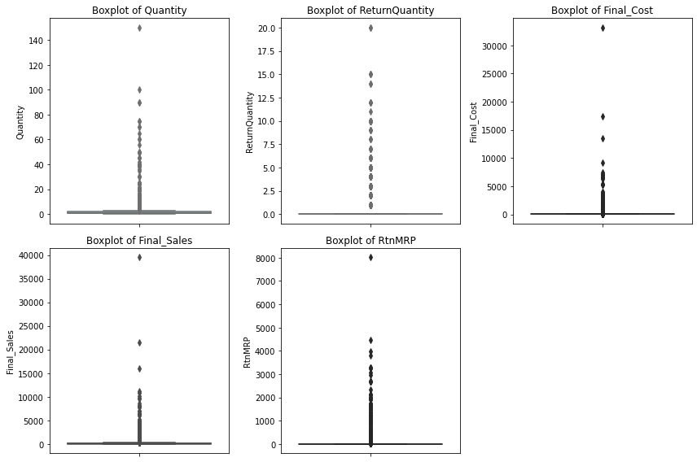
Exploratory Data Analysis [EDA]

Slide 21
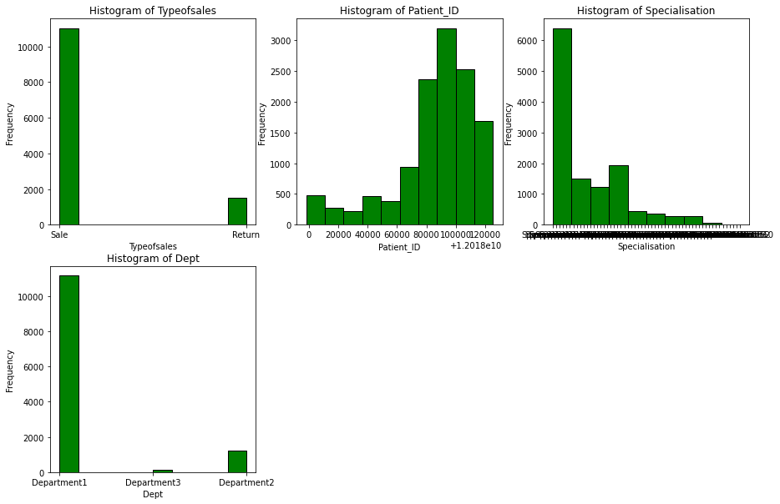
Exploratory Data Analysis [EDA]

Slide 22
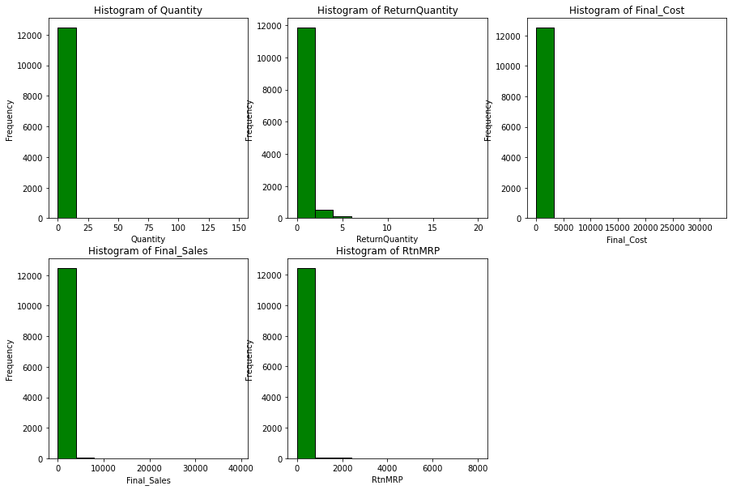
Exploratory Data Analysis [EDA]

Slide 23
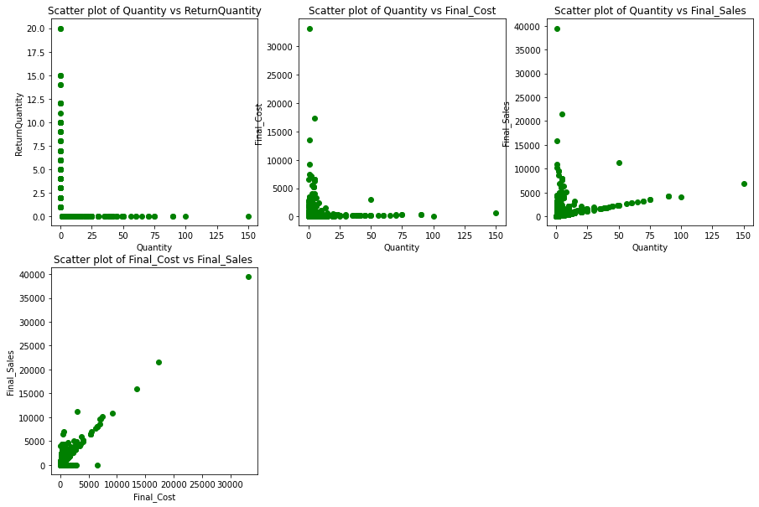
Exploratory Data Analysis [EDA]

Slide 24
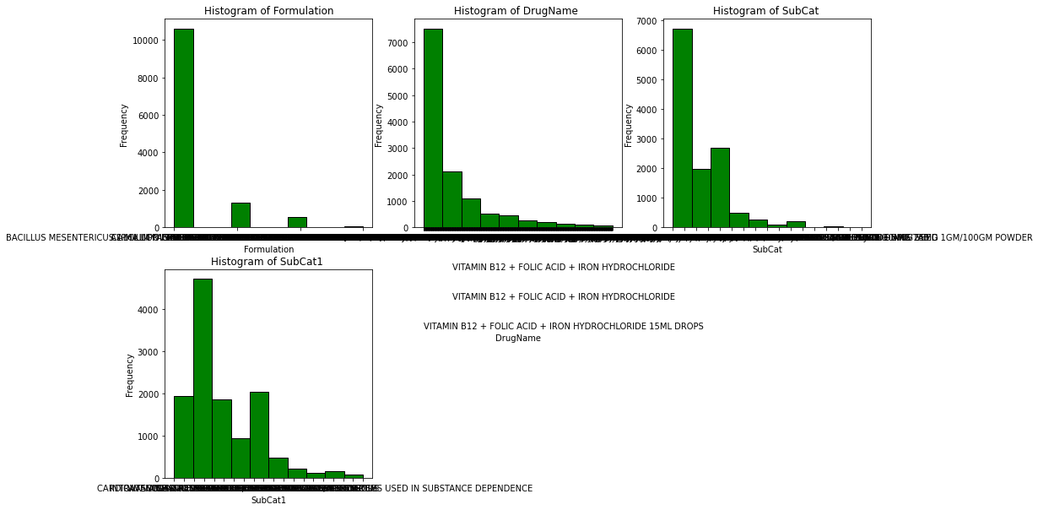
Exploratory Data Analysis [EDA]

Slide 25
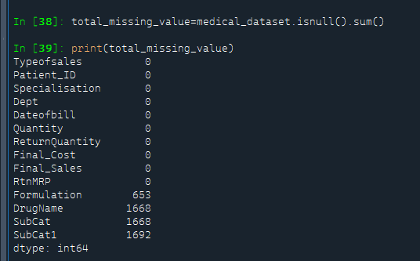
Missing Values Observation
In this Dataset, we observed missing values in the following columns: Formulation (653 missing values), DrugName (1668 missing values), SubCat (1668 missing values), and SubCat1 (1692 missing values).

Slide 26
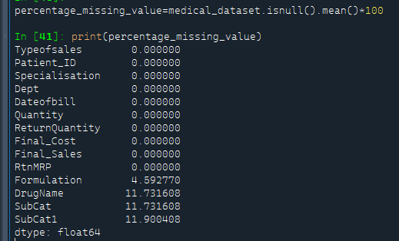
Missing Values Observation
Percentage Of Missing value

Slide 27
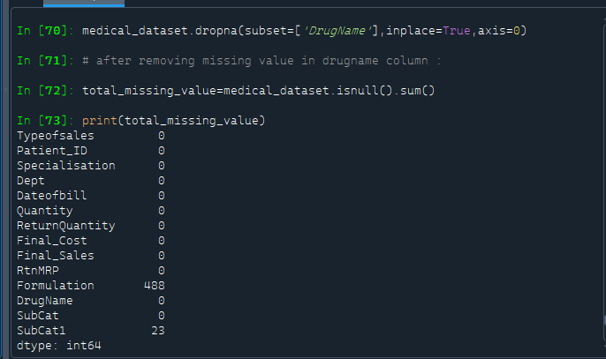
Missing Values Observation
Handling missing value:
In the Medical Inventory Optimization Dataset, we noticed a pattern where missing values in the 'drugname' column correspond to missing values in the 'subcat' and 'subcat1' columns. Therefore, we decided to drop the rows with missing values specifically in the 'drugname' column.
After dropping missing values from the 'drugname' column, there are still missing values remaining in the 'formulation' column (488 missing values) and the 'subcat1' column (23 missing values).

Slide 28
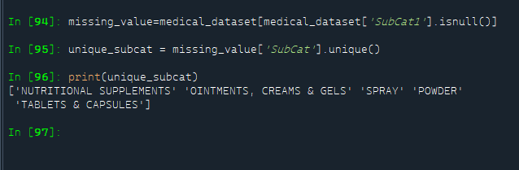
Missing Values Observation Handling Missing value in ‘Subcat1’ Column:
Here, we performed logical imputation by looking for the closest record and assigning the missing value with the corresponding value in the closest record.
First step is to filters rows from the column ‘Subcat’ where the 'SubCat1' column is null, meaning it contains missing values. The resulting DataFrame is stored in the variable missing_value. Identify the unique ‘subcat ’ column associated with the missing values in 'SubCat1'.
There are 5 unique value:
'NUTRITIONAL SUPPLEMENTS'
'OINTMENTS, CREAMS & GELS'
'SPRAY'
'POWDER'
'TABLETS & CAPSULES'

Slide 29
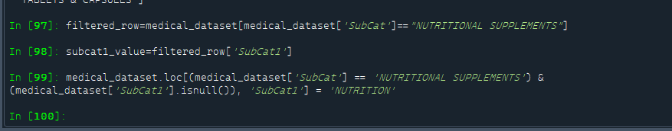
Missing Values Observation
Filters rows from the medical dataset where the 'SubCat' column equals "NUTRITIONAL SUPPLEMENTS".
Then captures the existing values of 'SubCat1' for rows where 'SubCat' is "NUTRITIONAL SUPPLEMENTS".
Locates rows in the medical dataset where 'SubCat' is "NUTRITIONAL SUPPLEMENTS" and 'SubCat1' is null. It then assigns the value 'NUTRITION' to these null entries in the 'SubCat1' column.

Slide 30
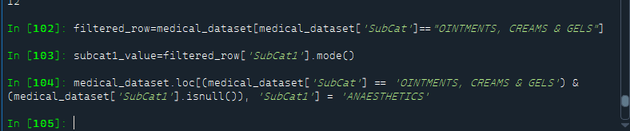
Missing Values Observation
Filters rows from the medical dataset where the 'SubCat' column equals "OINTMENTS, CREAMS & GELS".
Find the most common subcat1 within the "OINTMENTS, CREAMS & GELS" category.
Locates rows in the medical dataset where 'SubCat' is "OINTMENTS, CREAMS & GELS" and 'SubCat1' is null. It then assigns the value 'ANAESTHETICS' to these null entries in the 'SubCat1' column.

Slide 31
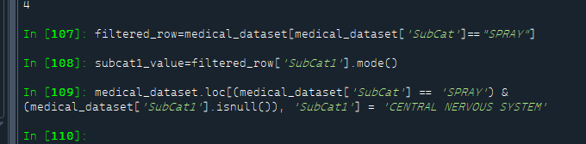
Missing Values Observation
Filters rows from the medical dataset where the 'SubCat' column equals "SPRAY".
Find the most common subcat1 within the "SPRAY" category.
Locates rows in the medical dataset where 'SubCat' is "SPRAY" and 'SubCat1' is null. It then assigns the value 'CENTRAL NERVOUS SYSTEM' to these null entries in the 'SubCat1' column.

Slide 32
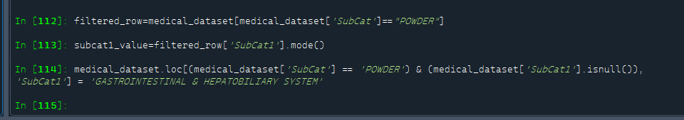
Missing Values Observation
Filters rows from the medical dataset where the 'SubCat' column equals "POWDER".
Find the most common subcategory within the "POWDER" category.
Locates rows in the medical dataset where 'SubCat' is "POWDER" and 'SubCat1' is null. It then assigns the value 'GASTROINTESTINAL & HEPATOBILIARY SYSTEM' to these null entries in the 'SubCat1' column.

Slide 33
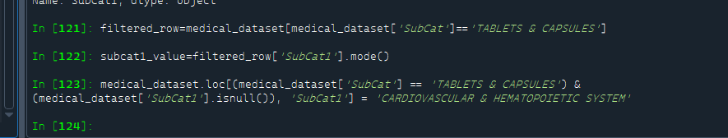
Missing Values Observation
Filters rows from the medical dataset where the 'SubCat' column equals "TABLETS & CAPSULES".
Find the most common subcat1 within the "TABLETS & CAPSULES" category.
Locates rows in the medical dataset where 'SubCat' is "TABLETS & CAPSULES" and 'SubCat1' is null. It then assigns the value 'CARDIOVASCULAR & HEMATOPOIETIC SYSTEM' to these null entries in the 'SubCat1' column.

Slide 34
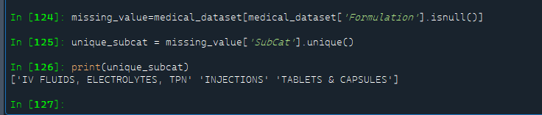
Missing Values Observation
Handling Missing value in ‘Formulation’ Column:
First identifying rows in the medical dataset where the 'Formulation' column is null. Then, it is extracting unique values from the 'SubCat' column for those rows. The output suggests that the missing values in the 'Formulation' column are associated with three unique subcategories:
'IV FLUIDS, ELECTROLYTES, TPN'
'INJECTIONS'
'TABLETS & CAPSULES'.

Slide 35
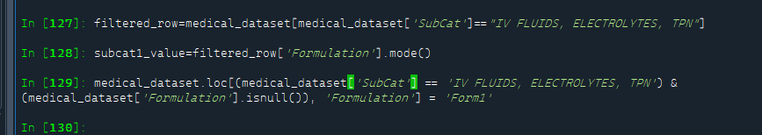
Missing Values Observation
Filters rows from the medical dataset where the 'SubCat' column equals "IV FLUIDS, ELECTROLYTES, TPN".
Find the most common formulation within the "IV FLUIDS, ELECTROLYTES, TPN" category.
Locates rows in the medical dataset where 'SubCat' is "IV FLUIDS, ELECTROLYTES, TPN" and 'Formulation' is null. It then assigns the value 'Form1' to these null entries in the 'Formulation' column.

Slide 36
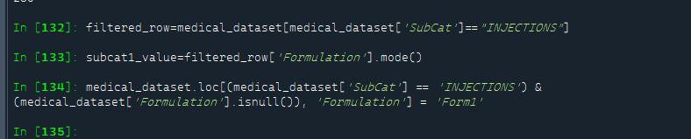
Missing Values Observation
Filters rows from the medical dataset where the 'SubCat' column equals "INJECTIONS".
Find the most common formulation within the "INJECTIONS" category.
Locates rows in the medical dataset where 'SubCat' is "INJECTIONS" and 'Formulation' is null. It then assigns the value 'Form1' to these null entries in the 'Formulation' column.

Slide 37
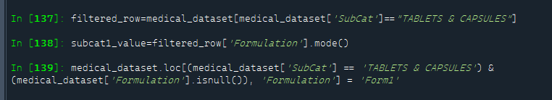
Missing Values Observation
Filters rows from the medical dataset where the 'SubCat' column equals "TABLETS & CAPSULES".
Find the most common formulation within the "TABLETS & CAPSULES" category.
Locates rows in the medical dataset where 'SubCat' is "TABLETS & CAPSULES" and 'Formulation' is null. It then assigns the value 'Form1' to these null entries in the 'Formulation' column.

Slide 38
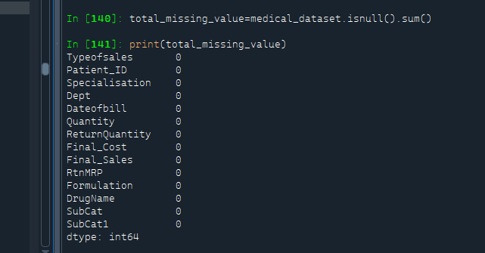
Missing Values Observation
Final output after handling missing values

Slide 39
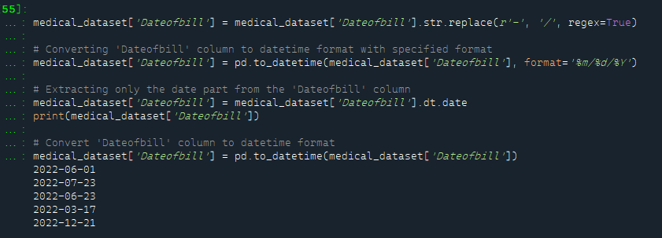
Data Preprocessing
Type casting:
In the Medical Inventory Optimization Dataset, the 'dateofbill' column is not in the correct format; it should be in the date data type, but it is currently in the object data type. We need to convert the 'dateofbill' column from the object data type to the date data type.
Notes:
Keep observations

Slide 40
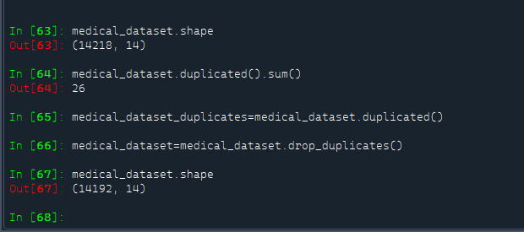
Data Preprocessing
Duplication Handling:
In the Medical Inventory Optimization Dataset, there are 26 duplicated records. We have removed these 26 duplicated records from the dataset.
After removing the duplicated records, the dataset contains 14,192 out of the original 14,218 records.

Slide 41
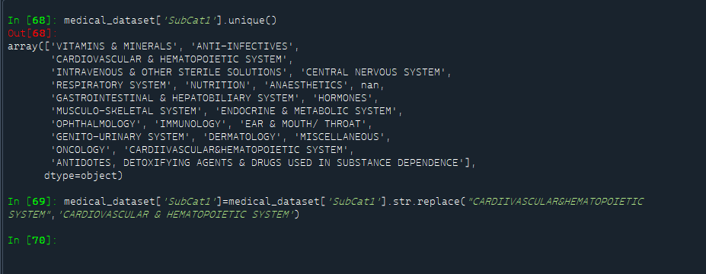
Data Preprocessing
Replacing value:
In the Medical Inventory Optimization Dataset, we noticed that in the 'subcat1' column, two values appear to be the same but with differences in spacing. Specifically, 'CARDIOVASCULAR & HEMATOPOIETIC SYSTEM' and 'CARDIIVASCULAR&HEMATOPOIETIC SYSTEM' are equivalent. Therefore, we are replacing 'CARDIIVASCULAR&HEMATOPOIETIC SYSTEM' with 'CARDIOVASCULAR & HEMATOPOIETIC SYSTEM'.

Slide 42
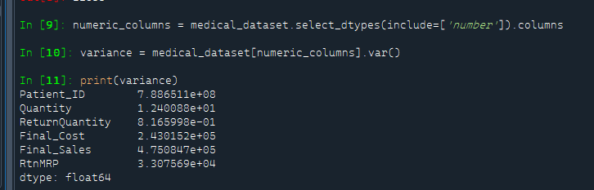
Data Preprocessing
Zero variance:
In the Medical Inventory Optimization Dataset, there is no column with zero variance

Slide 43
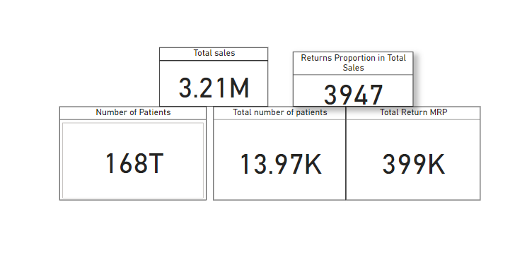
Data Visualization
Cards:
For the data visualization, we start by presenting the following Cards Which shows:
Returns Proportion in Total Sales(3947) ,Number of Patients( 168T), Total Number of Patients( 13.97k), Total return MRP(399k),Total final sale(3.21 million).
Notes:
Add graphical

Slide 44
Data Visualization
Cards:
For the data visualization, we start by presenting the following Cards Which shows:
Returns Proportion in Total Sales(3947) ,Number of Patients( 168T), Total Number of Patients( 13.97k), Total return MRP(399k),Total final sale(3.21 million).
Notes:
Add graphical

Slide 45
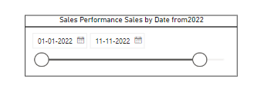
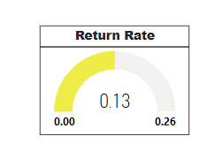
Data Visualization
Slicer : Gauge:
Here Slicer indicates Sales performance by Date wise here gauge indicates Return rate (0.13)
Notes:
Add graphical

Slide 46
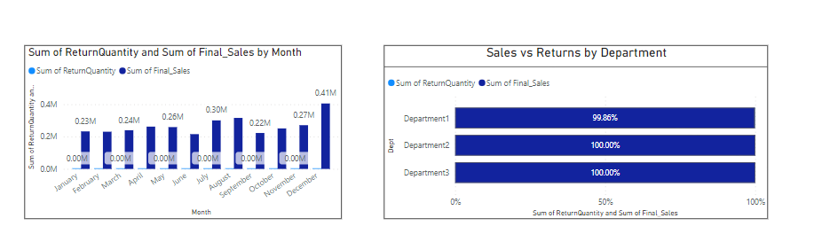
Data Visualization
Line and Clustered column chart: Stacked bar Chart:
Here Line and Clustered column chart is indicates Here Stacked bar Chart is indicates sales vs Sum of return Quantity and sum of final sales by month. Reveturns By each department .
Notes:
Add graphical

Slide 47
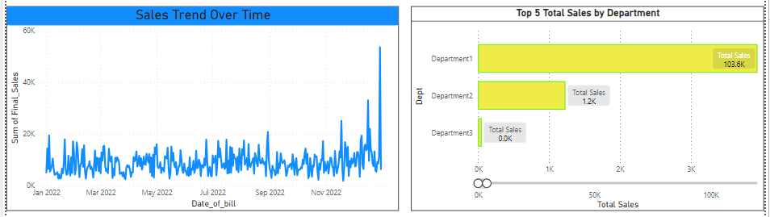
Data Visualization
Line chart: Clustered bar Chart:
Here Line Chart is indicates Sales trend over Time . Here Clustered bar Chart is indicates Top 5 sales by ……………………………………………………………………………………...…department .
Notes:
Add graphical

Slide 48
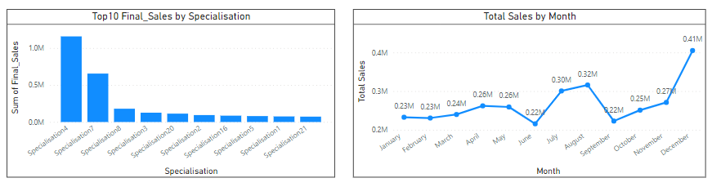
Data Visualization
Clustered column chart: Line chart:
Here Clustered Column Chart is indicates here Line chart is indicates Total Sales By Month. Top 10 final Sales By Specialisation.
Notes:
Add graphical

Slide 49
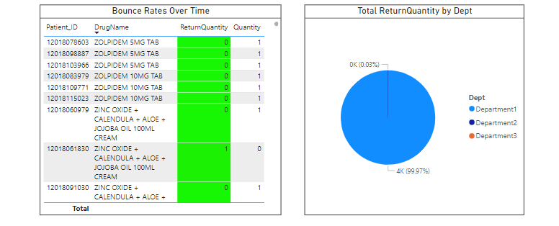
Data Visualization
Table Chart : Pie chart:
Here table Chart is indicates here Pie chart is indicates Total Return Quantity By Dept. Bounce rate over Time with Patients Ids.
Notes:
Add graphical

Slide 50
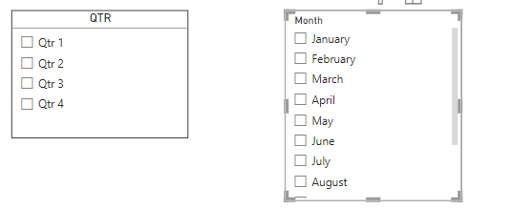
Data Visualization
Slicer Chart : here Slicer chart is indicates Financial QTR and Months.
Notes:
Add graphical

Slide 51
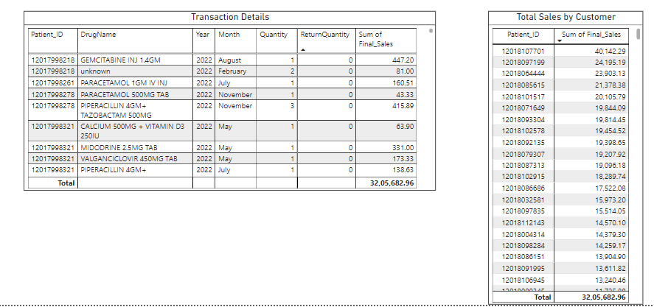
Data Visualization
Table Chart : here Table chart is indicates Transactional details and total Sales by each Customer.
Notes:
Add graphical

Slide 52
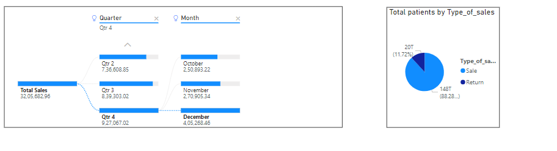
Data Visualization
Tree Chart : Tree Chart : here Tree chart is indicates Total Sales here pie chart is indicates Total patient’s type of sales details by each QTR and Month.
Notes:
Add graphical

Slide 53
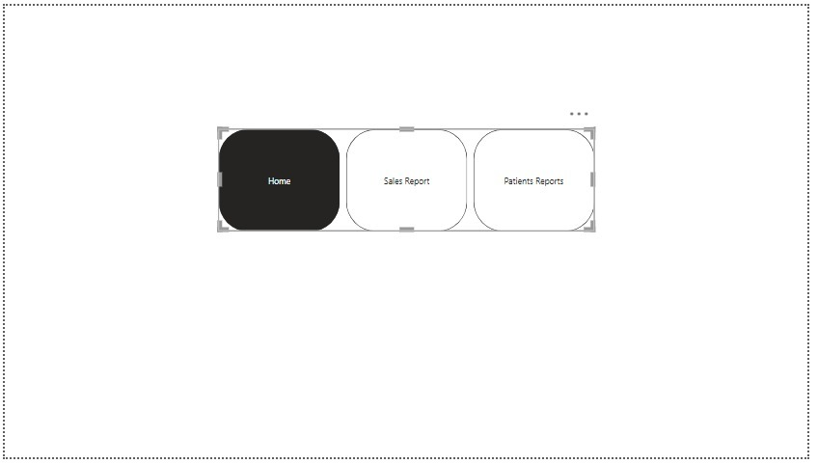
Screen shot of output
Notes:
Add graphical

Slide 54
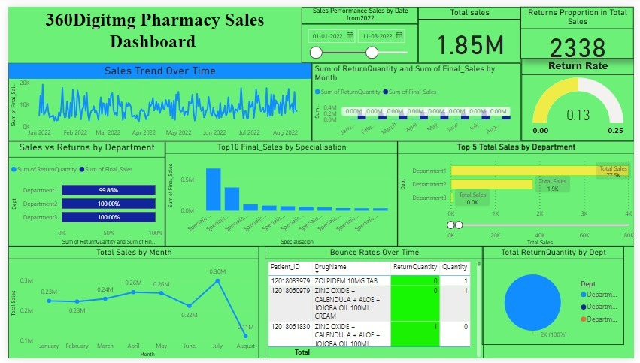
Screen shot of output
Notes:
Add graphical

Slide 55
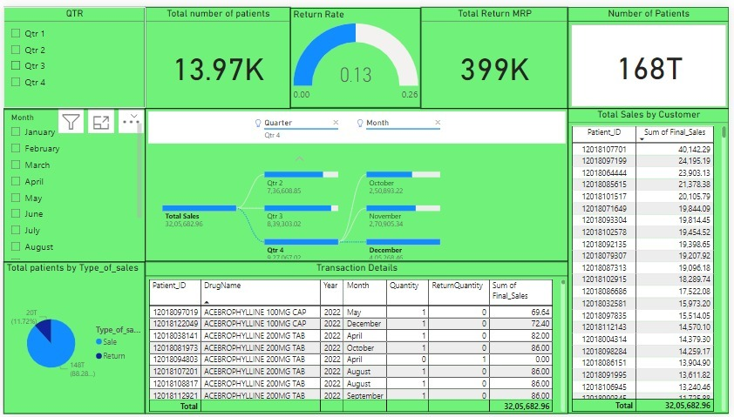
Screen shot of output
Notes:
Add graphical

Slide 56
Challenges
Missing values are present in the "drugname" column, accounting for a total quantity sold of 8266. Similarly, missing values in the "subcat1" column amount to a total quantity sold of 8298. These figures represent the highest total quantities sold for "drugname" and "subcat1," respectively.
Additionally, there are missing values in the "subcat" column, resulting in a total quantity sold of 8266, which is the second-highest total quantity sold. These missing values may lead to improper results for the dataset.

Slide 57
Future Scopes
Look into the reasons behind lower sales months (February and June) to understand if there are any specific factors affecting demand.
Investigate the reasons behind high return rates in certain months.
Focus on promoting high-selling drugname,subcat,subcat1 analyzing factors contributing to their success. Explore opportunities to expand sales channels or target new customer segments to increase overall sales.

Slide 58
Future Scopes
Recommendations
Focus on Subcategories: Analyze "INJECTIONS" and "TABLETS & CAPSULES" for higher returns, address issues causing returns, enhance customer satisfaction, and product quality.
Evaluation of Formulation: Thoroughly assess "Form1" formulation with highest returns, consider effectiveness, side effects, and customer preferences, explore improvements or alternatives.
Supplier Assessment: Evaluate suppliers, especially for "Form1" formulation, considering quality and reliability, explore alternatives if needed.
Inventory Management: Ensure efficient inventory for "Form1" formulation, optimize stock levels and expiration dates to minimize expired products.
Efficient Return Management: Implement streamlined return processes, improve inventory management, and address Department1-specific issues contributing to returns.
Specialisation-specific Strategies: Collaborate with Specialisation4 and Specialisation7 to understand reasons for returns, implement tailored strategies to reduce returns.
Seasonal Resource Allocation: Allocate resources based on seasonal demands, increase operations, inventory, and staffing during busy months, optimize resources during slow months.

Slide 59

Queries ?

Slide 60


